Slide 1
Heat Transfer (CH21204)
Conduction and Radiation
Class –X
Transient Conduction

Slide 2
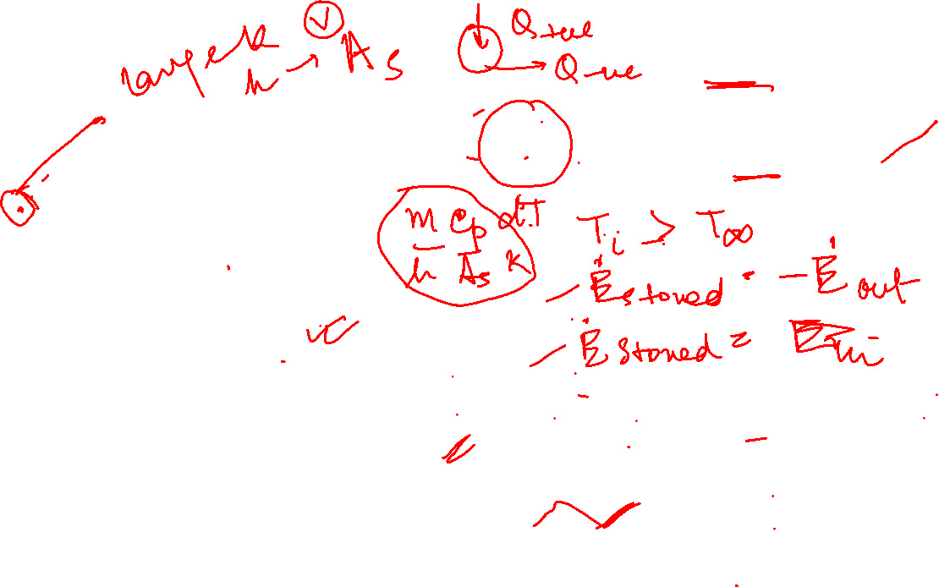
Cooling of a hot metal ball

Slide 3

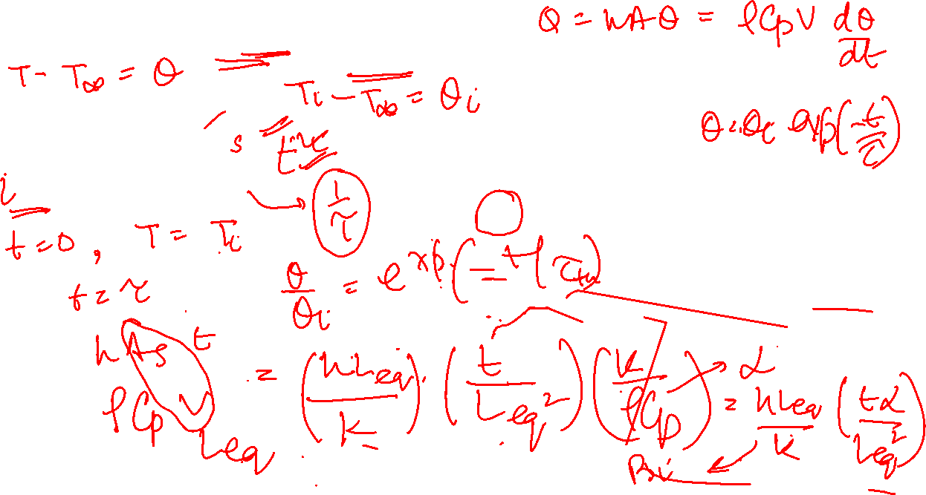
Transient temperature response of lumped capacitance solids for different thermal time constant τ

Slide 4
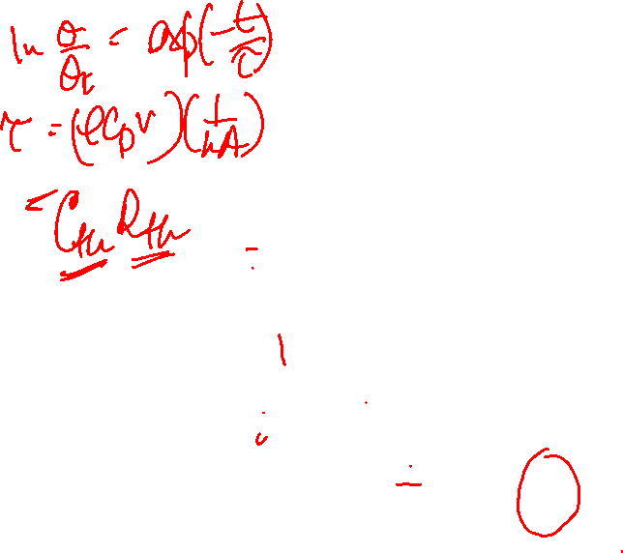
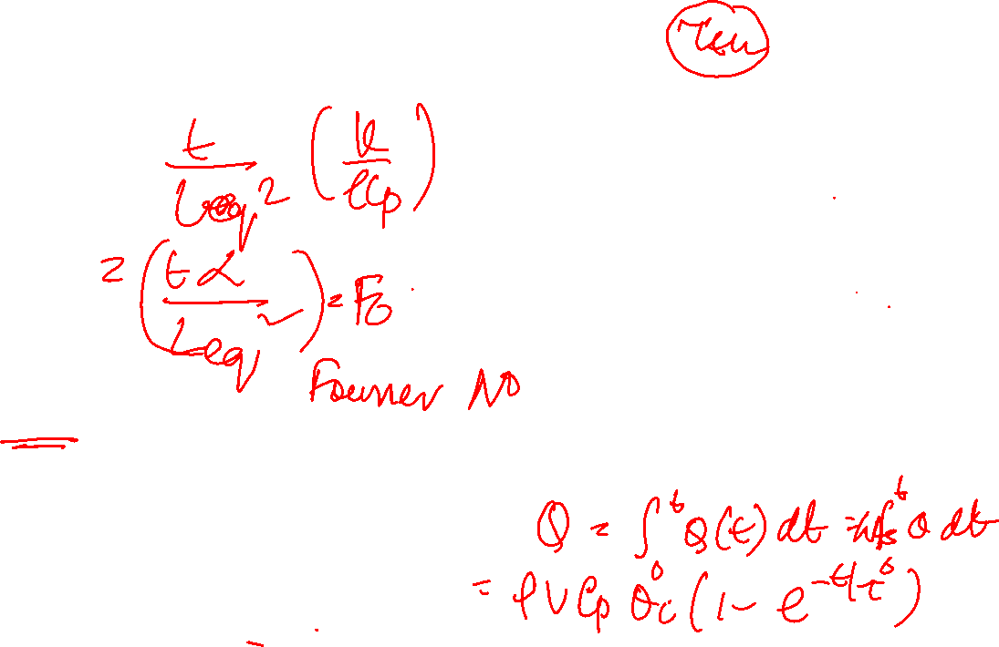
Transient temperature response of lumped capacitance solids for different thermal time constant τt

Slide 6

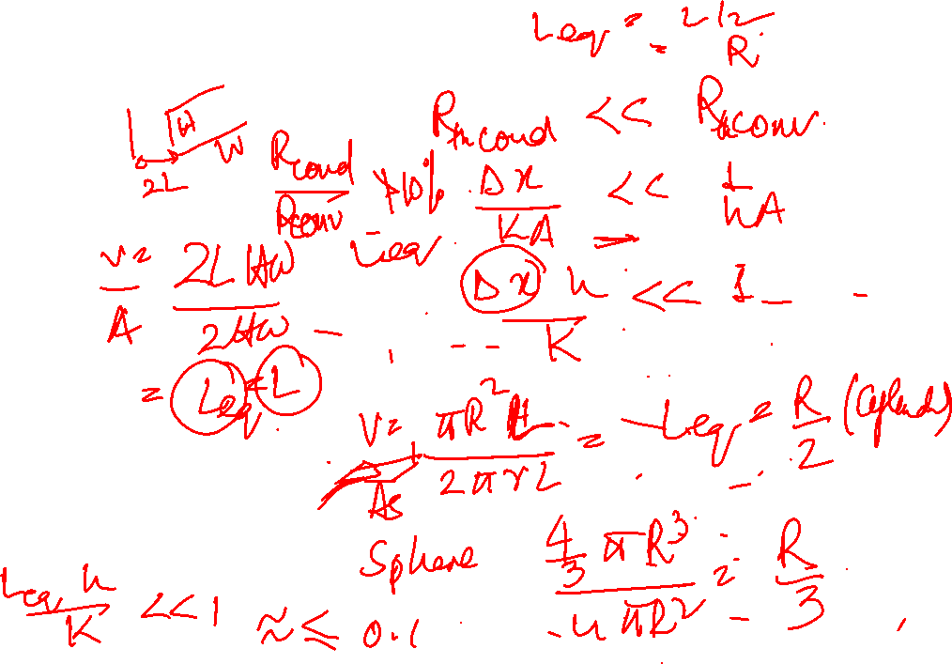
Effect of Biot number on steady state temperature distribution in a plane wall with surface convection

Slide 7
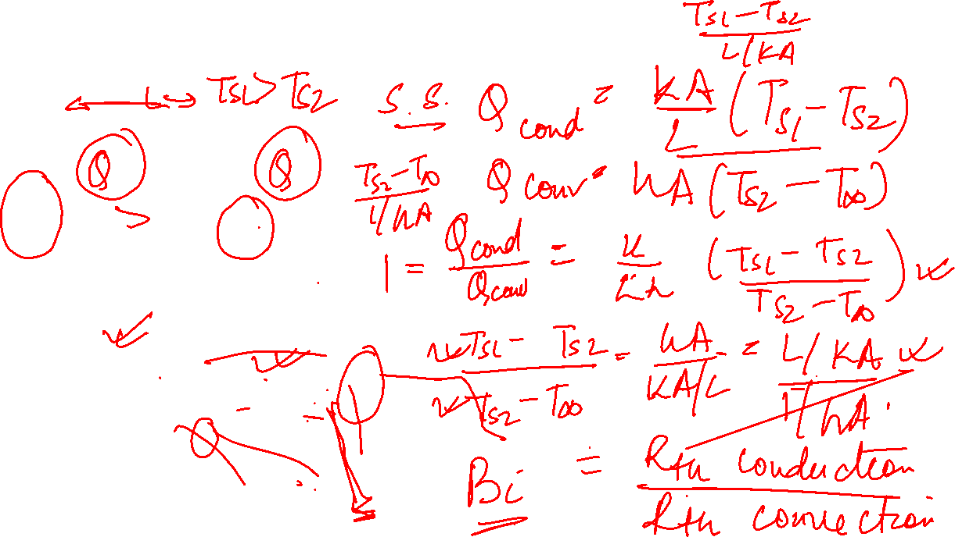
Effect of Biot number on steady state temperature distribution in a plane wall with surface convection

Slide 8
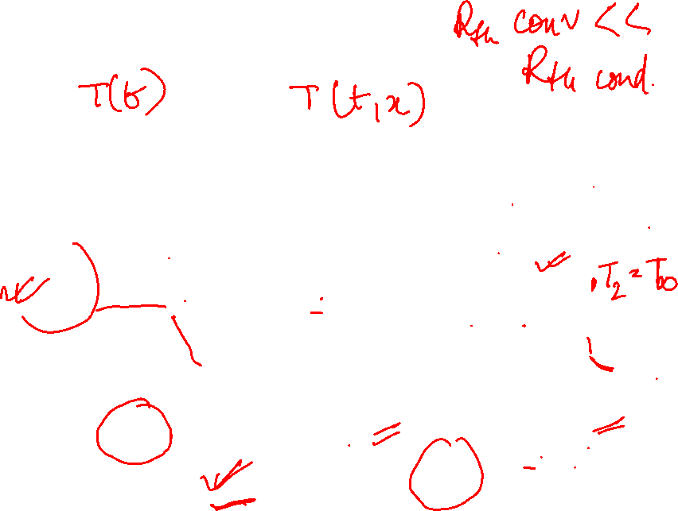
Transient temperature distribution for different Biot number in a plane wall symmetrically cooled by convection

Slide 9

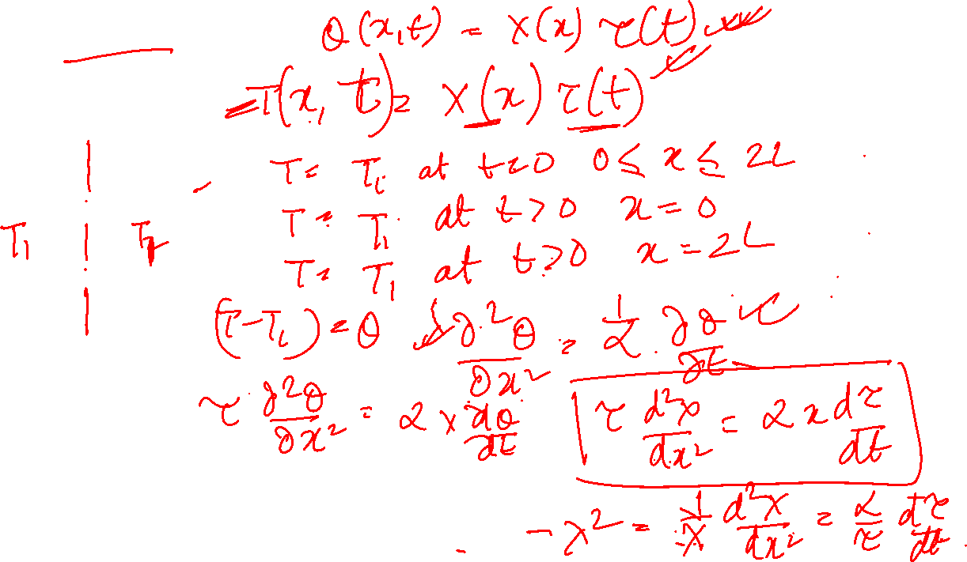
Infinite plane of thickness 2L

Slide 10
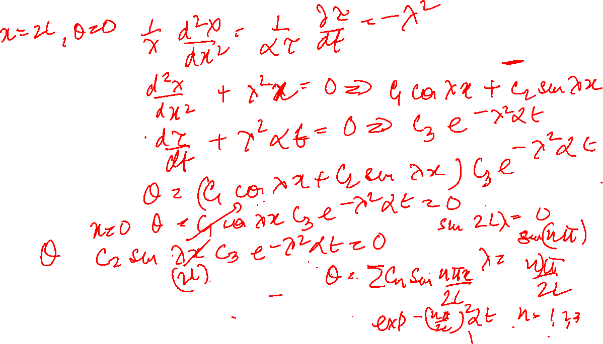
Infinite plane of thickness 2L

Slide 11
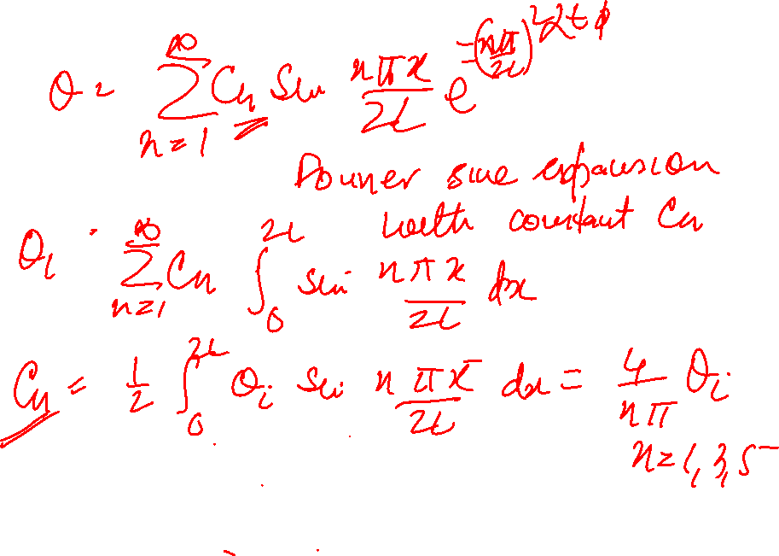
Infinite plane of thickness 2L

Slide 12
Infinite plane of thickness 2L

Slide 16
Example Problem:
A 5.0 cm diameter steel ball of specific heat capacity 0.46 kJ/kg (⁰C) is initially at a uniform temperature of 450⁰C. It is suddenly immersed in a fluid at 100 ⁰C (h = 10 W/m² ⁰C). Calculate the time required for ball to attain temperature of 150 ⁰C and the heat lost by the ball in this time period.

Slide 17
Heat Transfer (CH21204)
Conduction and Radiation
Class –X
Heat Transfer from Extended Surfaces
contd..

Slide 19
Fin Performance Parameters
Fin effectiveness, €_{f} = Fin heat transfer rate/Heat which would be transferred without fin
Fin efficiency, ⴄ_{f} = Actual heat transferred/Heat which would be transferred if entire fin at base temperature, T0

Slide 20
Efficiency of straight fins

Slide 21
Overall Surface Efficiency

Slide 22
Overall surface efficiency
Fin array
Rectangular fins
Annular fins

Slide 23
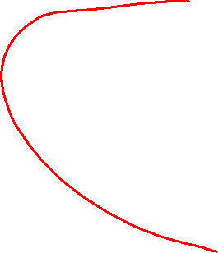
Example Problem
The engine cylinder of a motor cycle constructed of Aluminium alloy is of height 150 mm ad outer diameter 50 mm. 10 equally spaced annular fins, each of 6 mm thickness and 20 mm length, are integrally cast with the cylinder to reduce the temperature. For a heat transfer of 3 kW from cylinder to ambient at 300K (h = 75 W/m²(K)), estimate the reduction in cylinder temperature by use of fins.

Slide 24
Example Problem
The engine cylinder of a motor cycle constructed of Aluminium alloy is of height 150 mm ad outer diameter 50 mm. 10 equally spaced annular fins, each of 6 mm thickness and 20 mm length, are integrally cast with the cylinder to reduce the temperature. For a heat transfer of 3 kW from cylinder to ambient at 300K (h = 75 W/m²(K)), estimate the reduction in cylinder temperature by use of fins.

Slide 25
Heat loss from fin-wall combination

Slide 26
Conditions when fins do not help
Compare the heat transfer with and without fin for a SS pin fin (k =16W/m.K), L = 10 cm, d = 1 cm which is exposed to boiling water (h= 5000 W/m²(K).

